Slide 1
2021 Payroll Update
Romeo Chicco
PayMaster
These slides are for discussion purposes only. Distribution only with permission from Romeo Chicco.

Slide 2
COVID-19

Slide 3
Employer OASDI Deferral
Available for employers to defer their share of OASDI (aka Social Security) tax on wages paid through December 31, 2020
Repayment
50% (or more) on or before December 31, 2021
Balance on or before December 31, 2022
Collection is currently unknown
Sent a bill from the IRS on or before due dates?
Expected to remember and voluntarily pay?
Notes:
Can use with with PPP forgiveness. This was changed in the Flexibility Act

Slide 4
Employee FICA Deferral
Eligibility max wages of up to $4,000 biweekly (any more and employee is not eligible on that check)
Effective on wages paid from September 1, 2020 through December 31, 2020
Employer option to offer (we have not seen a single company allow deferral)
Employee Sign up, although employer can mandate
Repayments January 1, 2021 through April 30, 2021
Employee Termination?
Collection liability for the employer
Notes:
Presidents Executive Order

Slide 5
Families First Coronavirus Response Act (FFCRA)
6 (but really 5) reasons for leave related to COVID-19
Sick leave and/or Family leave (up to 2 weeks leave)
Emergency FMLA for employee staying at home to care for a school aged child (up to 10 weeks leave)
Wages paid and employer federal taxes are taken as an immediate tax credit on next 941 deposit
Expires 12/31/2020 (extension?)
Notes:
500 or employees or less.
Mandatory to offer.
Very few exemptions.

Slide 6
Reasons
is subject to a Federal, State, or local quarantine or isolation order related to COVID-19;
has been advised by a health care provider to self-quarantine related to COVID-19;
is experiencing COVID-19 symptoms and is seeking a medical diagnosis;
is caring for an individual subject to an order described in (1) or self-quarantine as described in (2);
is caring for a child whose school or place of care is closed (or child care provider is unavailable) for reasons related to COVID-19; or
is experiencing any other substantially-similar condition specified by the Secretary of Health and Human Services, in consultation with the Secretaries of Labor and Treasury.

Slide 7
Wages

Slide 8
House Passed Bill that Increases Minimum Wage to $15 by 2025
The House of Representatives has passed a bill (H.R. 582, the Raise the Wage Act) that would increase the minimum wage to $15.00 per hour in six increments by 2025. The first increment would increase the federal minimum wage from $7.25 per hour to $8.55 per hour. The bill would prescribe the Secretary of Labor to determine the minimum wage annually based on the annual percentage increase, if any, in the median hourly wage of all employees as determined by the Bureau of Labor Statistics.
The federal minimum wage was last increased in 2009.
Twenty-nine states and the District of Columbia already have a minimum wage rate greater than $7.25 per hour.
Notes:
Bill passed late 2019

Slide 9
8 States On Their Way To $15
California - $15 by 2022/2023
Connecticut - $15 by 2023
Florida - $15 by 2025
Illinois - $15 by 2025
Maryland - $15 by 2025
Massachusetts - $15 by 2023
New Jersey - $15 by 2024
New York - $15 by 2019/2021
Notes:
Florida vote passed 60/40
1/1/2021 $8.65 9/30 $10.00 $1 each year after 9/30

Slide 10
Minimum Wage
18 states, plus the District of Columbia, index their minimum wages to rise automatically with the cost of living. Alaska, Arizona, California, Colorado, Connecticut, Florida, Maine, Minnesota, Missouri, Montana, Nevada, New Jersey, New York, Ohio, Oregon, South Dakota, Vermont, and Washington
Over 20 states have 2021 minimum wage increases so far.
Many localities have adopted minimum wages above their state minimum wage. (CA, NY, WA)
Notes:
FL to index starting 9/30/2027
Keep an eye out for our blog on minimum wage changes.

Slide 11
FLSA Exempt
Salary test - $684 week (up from $455, effective 1/1/2020)
Highly compensated $107,432
No changes to Duties Test
Executive
Administrative
Professional
Teachers & Law & Medicine
Highly compensated
Computer professionals
US territories
Motion picture industry
State rules
States that have exempt $ higher than federal including the new threshold – Must use state rules if more favorable to employee: California, Maine, and New York
Notes:
Example California $1,040 per week for 26 or more employees or $960 per week for smaller.

Slide 12
Forms

Slide 13
2021 W-4
New form, but don’t panic. Practically same as this year except for tax tables
The pre-2020 W-4 withholding tables are gone on 1/1/2021
All employees need to be on the new W-4 form 2020 or 2021 before their first check of the new year.
Otherwise their withholding should be Single and no reductions. * IRS has published that they will produce a ‘bridge’ table for 2021 withholding.
IRS encourages paycheck checkup
https://www.irs.gov/paycheck-checkup
Notes:
This year we had dual tax tables

Slide 14
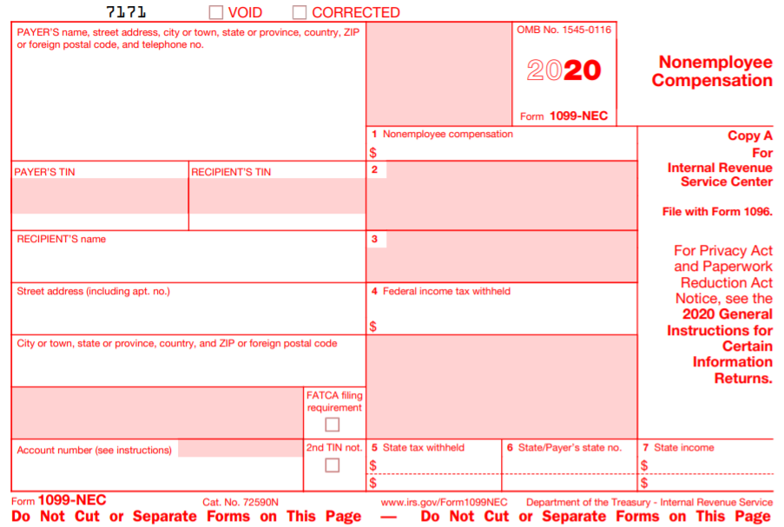
New 1099-NEC
For tax year 2020
Non Employee Compensation
Notes:
For was last used in 1982

Slide 15
W-2 SSN
PATH Act of 2015
To aid in the protection of employee identity theft
Truncate SSN on the employee’s copy of the Form W-2
***-**-1234 or xxx-xx-1234
Optional for employers starting in 2021 (2020 Form)
States?
Notes:
1 state responded

Slide 16
Missing or Incorrect SSN
IRS updates establishing reasonable cause
To support that the failure to include a correct TIN was due to reasonable cause and not willful neglect, filers must establish that they “acted in a responsible manner” both before and after the failure occurred and that: (a) there were significant mitigating factors (for example, an established history of filing information returns with correct TINs), or (b) the failure was due to events beyond the filer's control (for example, actions of the payee or any other person).
Notes:
Last year SSA sent out Educational Correspondence (EDCOR) letter

Slide 17
Taxpayer First Act (HR 3151)
Lowers the threshold for mandatory electronic filing of certain information statements (e.g. Forms W-2 and 1099) to the federal government. The current threshold for mandatory electronic filing is 250 statements of any one kind. The threshold drops to 100 statements for tax year 2021 (filed in 2022) and drops again to 10 statements for tax year 2022 (filed in 2023) and subsequent years.
Notes:
Became law 2019

Slide 18
Taxes

Slide 19
Teleworking employee
AL - withholding requirements for businesses will not change based on an employee who is temporarily teleworking within Alabama due to COVID-19. ADOR will not consider temporary changes in an employee's physical work location during periods in which temporary telework required
OH - , during the state emergency as declared on March 9, 2020 and 30 days after the conclusion of the emergency, any day which an employee performs work at a location, including the employee's home, due to the state of emergency will be considered to be a day performing personal services at the employee's principal place of work

Slide 20
SUI
SUI Taxable Wage Base Increases
NJ 35,300 to 36,200
WA 52,700 to 56,500
NV32,500 to 33,400
CO 13,600 to 17,000
IA 31,600 to 32,400
Notes:
Florida $7,000

Slide 21
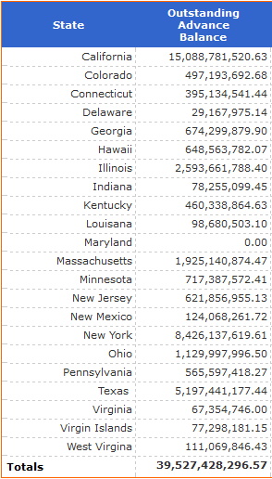
Outstanding balance the states have borrowed from the Federal Unemployment Trust Fund in order to pay unemployment benefits
Balance as of October 28, 2020
Repayment in full by Nov 10 following the second consecutive Jan 1
FUI rate is 6.0%, with credit of 5.4%, thus net rate of 0.6%
0.3% credit lost for each year balance is outstanding
Notes:
November 10 2022

Slide 22
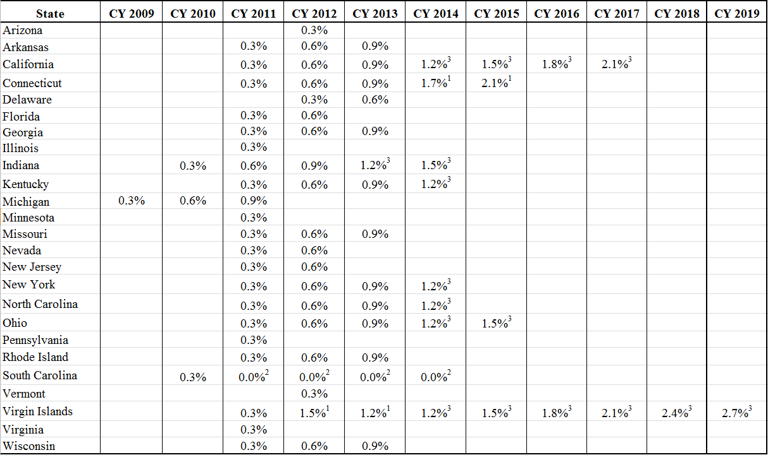
Notes:
Unemp 5% Jan 2008, 7.3% Dec 2008, max 10% Oct 2009
14.7% April 2020, 7.9% Sept 2020, 6.9% Oct 2020
Rates will increase for many states in December 2022 (retroactive to January)
Florida had $4 billion 3/31/2020 to about $1.1 billion 10/31

Slide 23
Other

Slide 24
Mandatory Sick Leave
14 states have enacted laws to require paid sick leave with others pending.
Nevada (1/1/2020) – .01923 hour per hour worked, companies with 50 or more employees
Maine (1/1/2021) – 1 hour for 40 hours worked, max 40 per year, companies with 10 or more employees
Pittsburgh (3/15/2021) – 5 days (large)/3 days (small) per year

Slide 25
California—Paid Family Leave Extended From 6 to 8 Weeks
The California paid family leave (PFL) law provides workers with partial pay each year while taking time off from work to bond with a newborn baby, or newly adopted or foster child, or to care for a seriously ill parent, child, spouse, or registered domestic partner. Through June 30, 2020, the maximum PFL each year is six weeks. Effective July 1, 2020, the maximum annual PFL will be eight weeks [L. 2019, S83].

Slide 26
California—Paid Family Leave
Beginning January 1, 2021, PFL will expand by adding a new claim type called Military Assist.
Available to eligible Californians who need time off work to participate in a qualifying event because of the military deployment of their spouse, registered domestic partner, parent, or child to a foreign country.

Slide 27
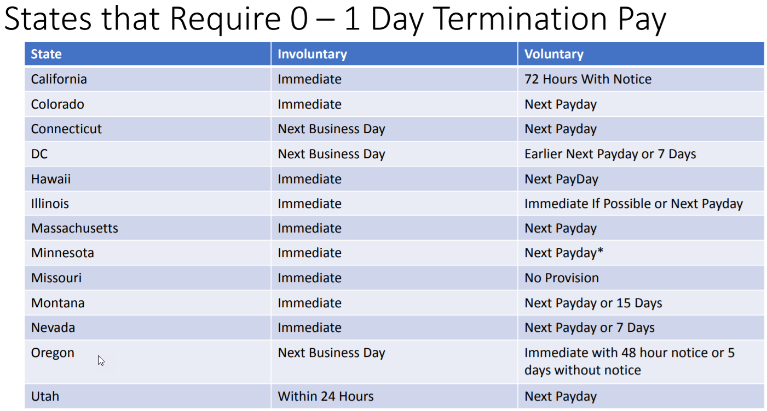

Slide 28
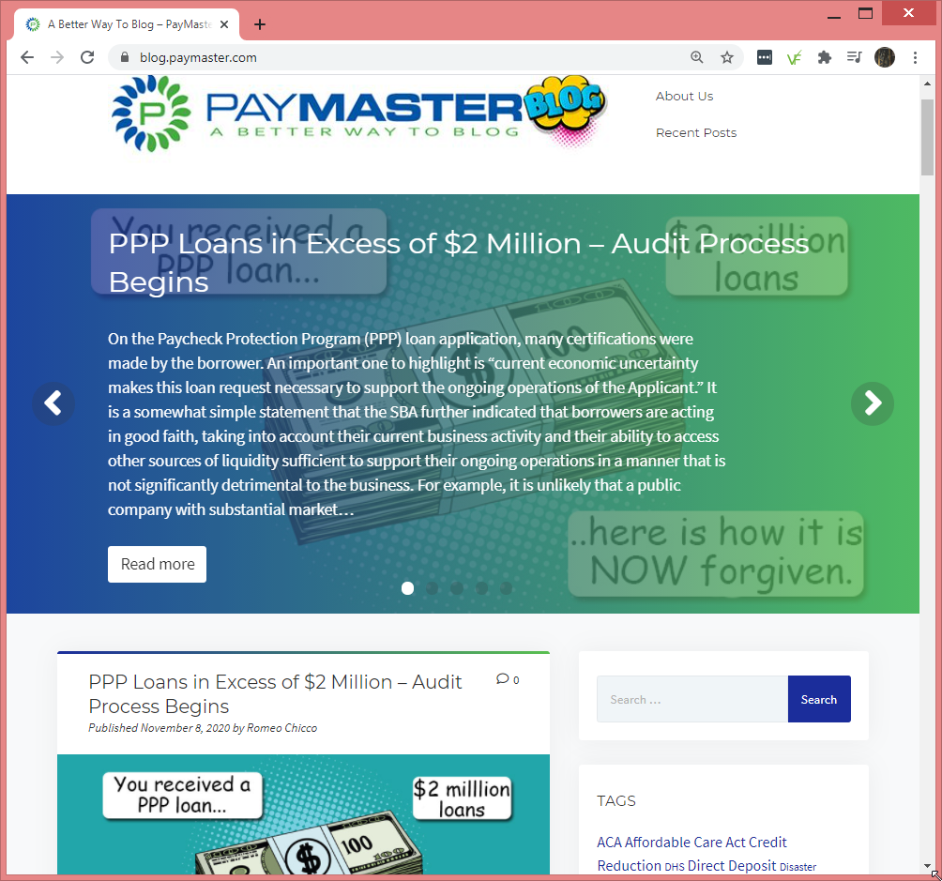
blog.paymaster.com
Notes:
Have written at least once a month since September 2015. A great resource for payroll info.

Slide 29
Thank you!

