Slide 1
The COVID-19 Pandemic & Unemployment Insurance

Slide 2
Employer
State Unemployment Agency
Claimant
Unemployment – Key Players
Provides quarterly employee payroll information
Pays UI charges/tax rate
Provides Information regarding claimants to state agency
Establishes employer tax rating method & schedule
Collects employer UI payments
Determines employer chargeability
Determines claimant eligibility
Distributes payments to claimant
Receives UI payments
Provides information regarding separation to state agency

Slide 3
Types of Employer Funding
 | Method of Payment | Eligibility
Tax Paying | Pay a quarterly tax based on a rate determined by the state unemployment agency | Are eligible to request non-charging on certain types of claims in most states
Non-Profit (Reimbursable) | Reimburse the state for actual unemployment benefits collected by former employees | Not Eligible for non-charging in most states

Slide 4
The Unemployment Claims Process
Separation Initiated
Claim Filed
Employer Protests
State Agency Issues Determination
Appeal Filed
UI Hearing
State Hearing Decision
Petition to Board of Review
Board of Review Determination
Employer
Participation/Consultation

Slide 5
COVID-19 & UI
Major Legislation
Families First Coronavirus Response Act
  Relaxed rules for state unemployment agencies (waiting week, work search)
  Provided funding for state unemployment agencies
The Coronavirus Aid, Relief, and Economic Security Act (CARES)
  Pandemic Unemployment Assistance
  Emergency UI Assistance for Government/Non-profits
  Emergency Increase in UI Benefits
  Temporary Funding for Waiving Waiting Week
  Pandemic Emergency Unemployment Compensation
  Short – Term Compensation

Slide 6
COVID-19 & UI
CARES ACT
Pandemic Unemployment Assistance (PUA)
UI for those who are not eligible for “regular” unemployment benefits through the state unemployment agency. Think of these as similar to Disaster Unemployment Benefits.
Basic Provisions:
To end December 31, 2020
Not to exceed 39 weeks
Includes all states and US territories
Benefit amount determined by state weekly benefit amounts
100% funded by the federal government
This includes individuals who:
Have exhausted regular and/or extended benefits under state or federal law
Are self employed, seeking part-time, does not have sufficient work history
Will not include:
Does not include worker able to telework with pay
Is receiving sick pay or other paid leave benefits
Other requirements to receive PUA:
The individual must be able available under state laws (which have been waived in most states)
Meets other criteria from secretary of unemployment
The reason for unemployment must be certified due to:
The individual or household/family member has been diagnosed with COVID-19 or is seeking diagnosis
The individual is providing care for diagnosed household/family member with COVID-19
The individual is caring for a child or individual who has school or facility closure due to COVID-19 and they cannot work as a result
The individual is unable to reach place of employment due to quarantine by a healthcare provider due to COVID-19
The individual was scheduled to work is unable to reach the job or no longer has work due to COVID 19
The individual has become head of household/major breadwinner due to the head of household dying due COVID 19
The individual quit their job as a direct result of COVID-19
The individual’s place of employment closed due to COVID-19

Slide 7

COVID-19 & UI
CARES ACT
Emergency Unemployment Relief for Governmental Agencies/Reimbursable
The federal government will reimburse nonprofits, government agencies, and Indian tribes for half of the costs they incur through December 31, 2020 to pay unemployment benefits.
The bill requests that state unemployment agencies are flexible interpretations of laws related to timely payments and assessments of penalties and interest.
The bill also provides a 50% reimbursement from the federal government to state unemployment agencies to be credited to the employer accounts for charges for benefits paid to individuals unemployed as a result of COVID-19
This begins March 13 and will end effective December 31, 2020.

Slide 8
COVID-19 & UI
CARES ACT
Emergency Increase in UI Benefits:
An additional $600 per week payment to each recipient of unemployment insurance or Pandemic Unemployment Assistance for up to four months, through July 31, 2020.
States can opt in to participate in the program
Individuals receiving regular unemployment benefits both (partial and full) receive an additional $600 payment
This will include individuals collecting Pandemic Unemployment Assistance.
The payment is made through the state unemployment agency either with the regular payment or separately as determined by the state.
Must be provided weekly to claimants.
Does not affect the duration or amount of state authorized unemployment benefits
100% federally funded
Terminable with 30 days notice
A state’s participation can be canceled if the state unemployment agency modifies duration or amount of benefits to claimants
These benefits are not to be considered compensation for other government programs including Medicaid and CHIP
This program ends effective July 31 2020

Slide 9
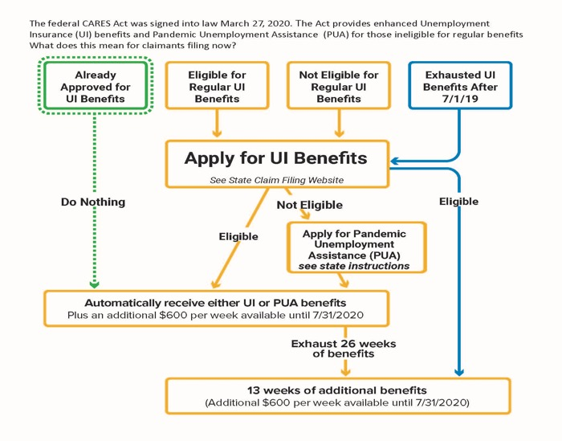
COVID-19 & UI
Who Gets What?!

Slide 10






INSERT TITLE
THE HARSH REALITY OF UNEMPLOYMENT DURING COVID
Enter content/quote here or delete
Unprecedented - Limit Expectations
Delays in all UI Documentation
Pending determinations / decisions
State contacts unreachable
Excess charges and delayed corrections
New processes - Hearings
Employee complaints
Problem states – CA, FL, MA and more
FRAUD

Slide 11

INSERT TITLE
Benefits Charges – COVID-19
What you can expect erroneous charges for:
Enter content/quote here or delete
Claims you never received
Claims you won
Claims the state never told you you lost
People who don’t work for you
Fraudulent claims
Employees who still work full time legitimately
Base period claims
RECOMMENDATION:
Look through EVERY charge on your statement, especially if a reimbursing employer

Slide 12

FRAUD
BACKGROUND:
Not your fault! – Information likely came from massive data breaches years ago
Consult CCC Fraud Guide for next steps
Ask around – If you get a claim for an active employee, ask if they filed
NEXT STEPS:
Respond to the claim indicating fraud
Have employee contact state per guide guidelines
Track claims marked as fraud

Slide 13
COVID UNEMPLOYMENT INSURANCE
How will you pay for this?
Tax Paying Employers
Reimbursing Employers
‘Social’ Tax – Most states are not having employers merit rate negatively impacted by COVID claims but will likely raise UI taxes for all employers.
Example – If your company is at lowest rate bracket of 1%, the state may increase the lowest rate bracket to 1.5%
50% - MOST states have indicated relief of 50% of benefit charges. Some are sending new bills out reflecting that, while others are asking to pay 100% and they will reimburse you.
Removed Late Payment Penalties – DON’T Pay until you have to.

Slide 14

What your organization can do RIGHT NOW
Consult CCC website regularly for updates
Monitor Benefit Charges
Prevent Fraud – Ask if employees filed if still active
Respond to all claims – If received untimely by state, indicate that in claim response
Monitor pending claims – mark if you received response / cross reference with benefit charges

Slide 15

COVID-19 & UI
What Comes Next?
Changes in Tax Rate Schedules (New Hampshire was first!)
Benefit Charge Reimbursements for Erroneous Charges
Increase Attention to Auditing
Increase in UI Integrity enforcement with penalties
More Relief?

Slide 16
COVID-19 & UI
Employer Resources
CCC’s COVID-19 UI Guide
State Agency Contacts Sheet
Fraud Guide
Bulletins for all legislative updates related to COVID-19 at CCC’s Website
Copy of presentation

Slide 17

What CCC Does for Your Company
Summary of Services
Up-To-Date – COVID Information
Benefit Charge Auditing
Administrative Burden
Consultation + Expertise
Collective Knowledge
Training
National Presence
Hearing Representation + Preparation
Limit Mail and Response Errors
Rapport with DOLs and BORs
Lobby for Employer Interests

Slide 18
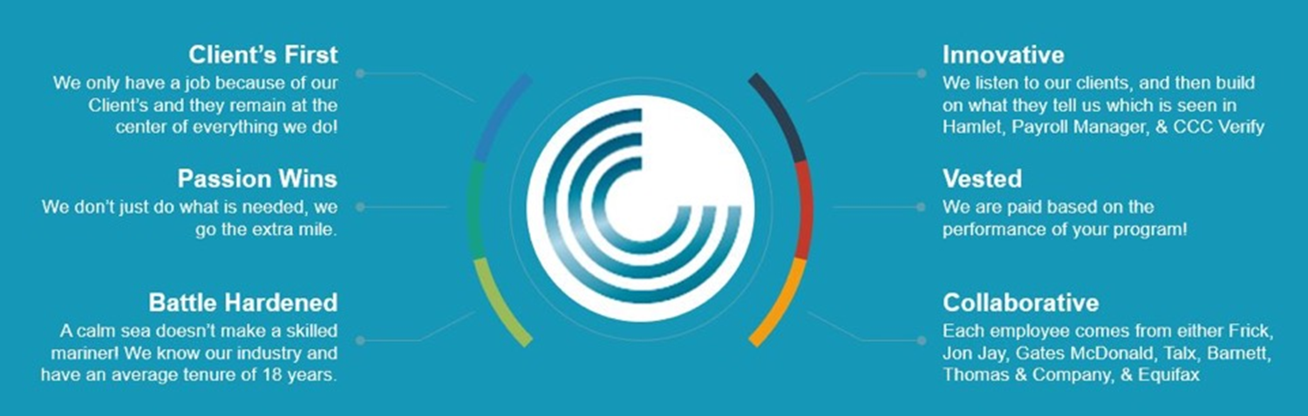
Questions?

